Slide 1
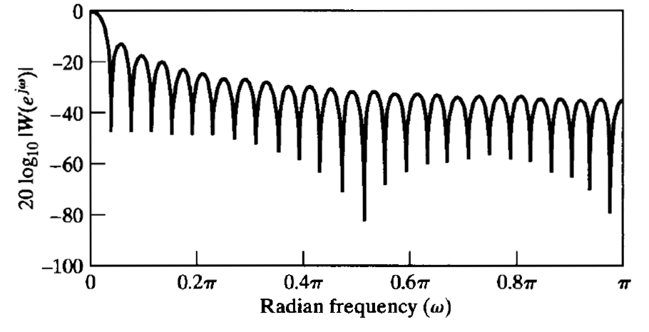
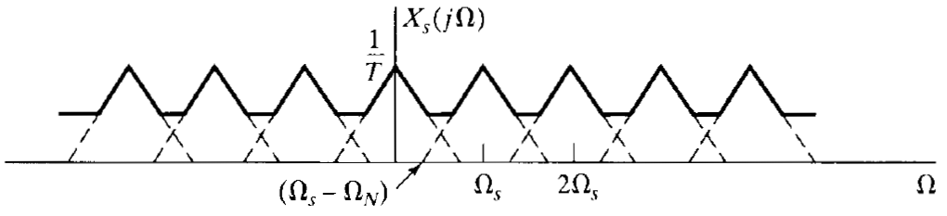
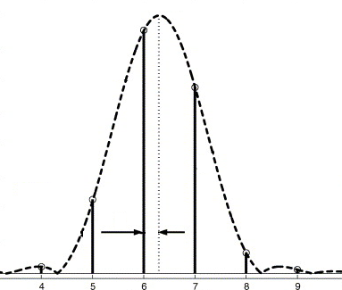
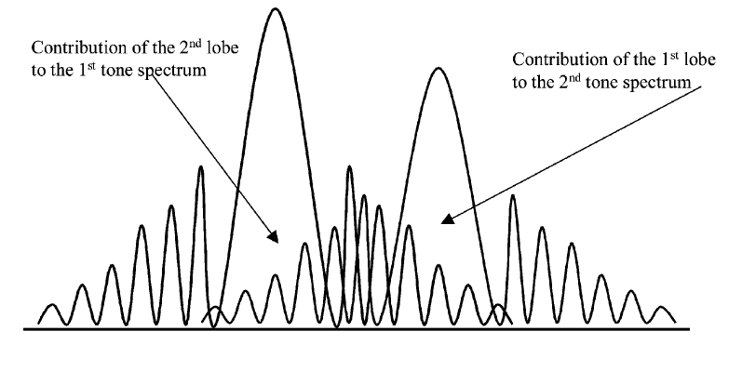
DFT-based synchrophasor estimation
Main sources of errors
 | 2. Long range leakage
3. Short range leakage | 4. Harmonic interference
1. Aliasing

Slide 2
DFT-based synchrophasor estimation
Possible corrections
Introduction of adequate anti-aliasing filters Increasing of the sampling frequency
Interpolated DFT methods
 | Use of appropriate windowing functions
 | Iterative compensation of the self-interaction
1. Aliasing | 2. Long range leakage
3. Short range leakage | 4. Harmonic interference

Slide 3
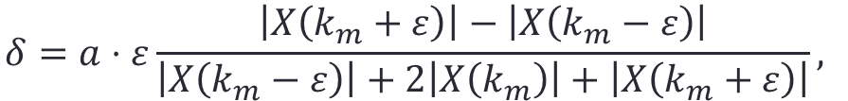
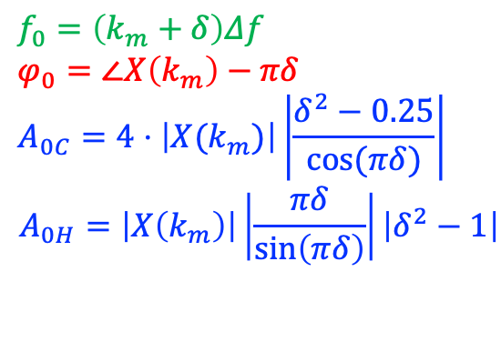

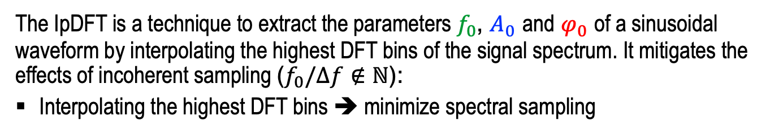



Joint P+M class synchrophasor estimation
IpDFT problem solution for $\cos^{α}$ window functions [1]
The IpDFT is a technique to extract the parameters $f_{0}$, $A_{0}$ and $φ_{0}$ of a sinusoidal waveform by interpolating the highest DFT bins of the signal spectrum. It mitigates the effects of incoherent sampling ($f_{0}/∆f∉ℕ$):
Interpolating the highest DFT bins ➔ minimize spectral sampling
$$δ=a⋅ε\frac{\left|X\left(k_{m}+ε\right)\right|−\left|X\left(k_{m}−ε\right)\right|}{\left|X\left(k_{m}−ε\right)\right|+2\left|X\left(k_{m}\right)\right|+\left|X\left(k_{m}+ε\right)\right|},$$
$a$ = 1.5 cos, $a$ = 2 hann
$$|X\left(k\right)|$$
$$f_{0}=\left(k_{m}+δ\right)Δf$$
$$φ_{0}=∠X\left(k_{m}\right)−πδ$$
$$A_{0C}=4⋅\left|X(k_{m})\right|\left|\frac{δ^{2}−0.25}{\cos{(πδ)}}\right|$$
$$A_{0H}=\left|X\left(k_{m}\right)\right|\left|\frac{πδ}{\sin\left(πδ\right)}\right|\left|δ^{2}−1\right|$$
$$δ$$
$$k$$
DFT bins
Pos image
Neg image

Slide 4

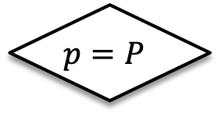
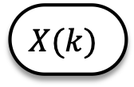


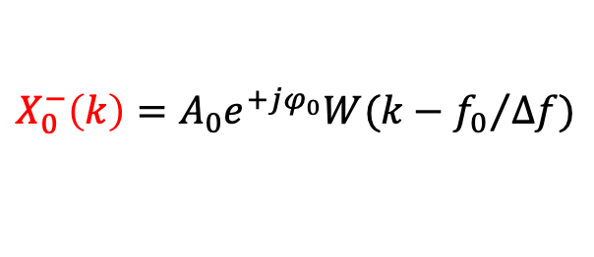

Joint P+M class synchrophasor estimation
Enhanced-IpDFT algorithm [1]
$$X(k)$$
$$|X\left(k\right)|$$
$$δ$$
IpDFT
$$δ$$
$$p=P$$
Estimated
Synchrophasor
yes
no
Negative image
estimation
$$X_{0}^{−}\left(k\right)=A_{0}e^{+jφ_{0}}W(k−{f_{0}}/{Δf})$$
Negative image
compensation
$$X_{0}^{+}\left(k\right)=X\left(k\right)−X_{0}^{−}\left(k\right)$$
$$k$$
IpDFT
DFT bins
DTFT
Fund pos im
Fund neg im

Slide 5




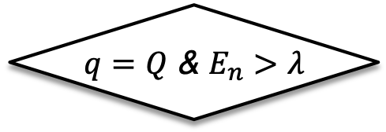
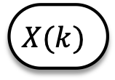

Joint P+M class synchrophasor estimation
Iterative-IpDFT algorithm [2]
$$X(k)$$
$$|X\left(k\right)|$$
e-IpDFT
$$δ$$
$$δ$$
$q=Q$ & $E_{n}>λ$
Estimated
Synchrophasor
yes
no
Main tone
estimation & compensation
$$X_{i}\left(k\right)=X\left(k\right)−X_{0}(k)$$
e-IpDFT
$$δ_{i}$$
Interharmonic tone
estimation & compensation
$$X_{0}\left(k\right)=X\left(k\right)−X_{i}(k)$$
$$k$$
e-IpDFT
DFT bins
Fund tone
Fund pos im
Int pos im
DTFT
Int tone
Fund neg im
Int neg im

Slide 6
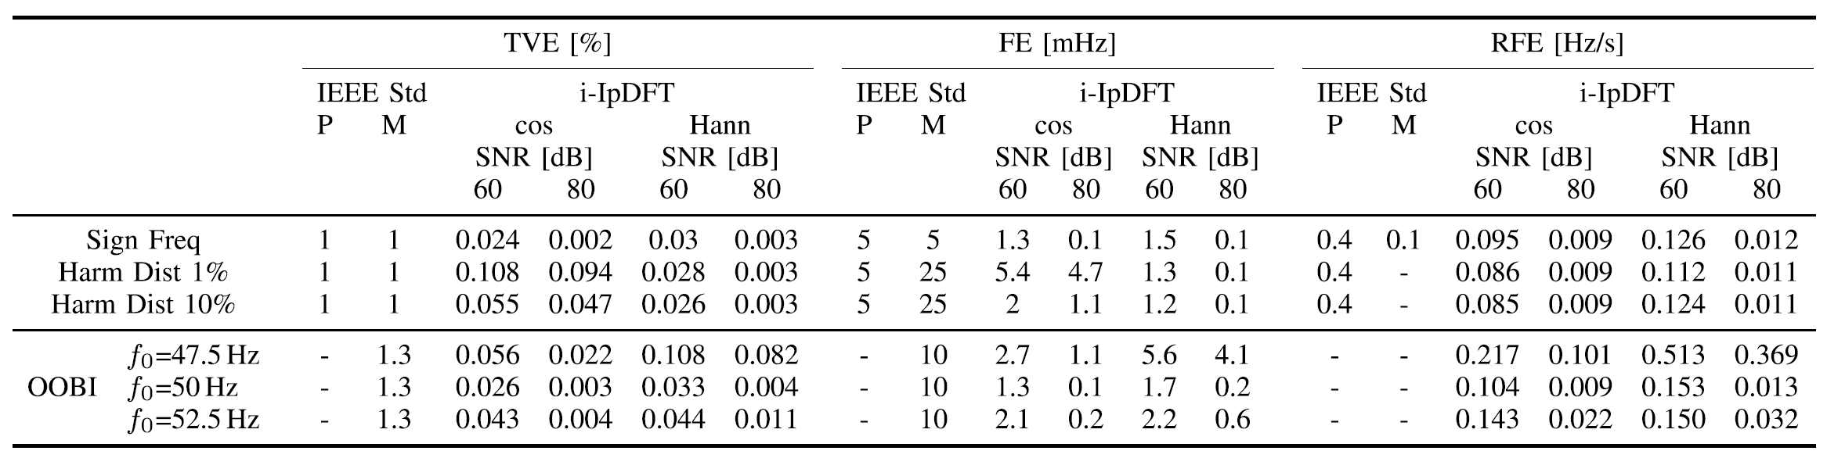
Joint P+M class synchrophasor estimation
Iterative-IpDFT algorithm performance and P+M compliance [2]
Static conditions

Slide 7
References
P. Romano and M. Paolone, “Enhanced interpolated-DFT for synchrophasor estimation in FPGAs: Theory, implementation, and validation of a PMU prototype,” IEEE Transactions on Instrumentation and Measurement, vol. 63, no. 12, pp. 2824–2836, Dec 2014.
A. Derviškadić, P. Romano and M. Paolone, “Iterative-Interpolated DFT for Synchrophasor Estimation: a Single Algorithm for P and M-class compliant PMUs”, IEEE Trans. on Instrumentation and Measurements, vol. 67, no. 3, pp. 547 - 558, March 2018.

